Slide 1

Multi-Agent Medical RAG
Deterministic Orchestration for Safe Medical AI
Technical Assessment | Role AI

Slide 2






The "Hospital Team" Approach
Standard RAG is a "black box." We replaced it with a Deterministic Orchestrator Pattern to ensure safety.
The Planner
RAG Agent
Evaluator
Role: Triage Nurse
Role: Specialist
Role: Auditor
Routes the user. Checks for emergencies. Decides who handles the case. Never treats (generates text).
Retrieves patient charts (Vector DB). The only agent allowed to give medical advice.
Reviews the doctor's notes for accuracy and hallucinations before releasing to patient.

Slide 3

System Architecture & Flow
1. User Query
2. Planner
3. Retrieval
4. Evaluator
"What is Type 2 Diabetes?"
Safety Check -> Route to RAG
FAISS Lookup (Top k=5)
Audit Factuality -> Score
Fail-Safe Mechanism: If Confidence < 40%, the answer is withheld and the system escalates to a safety disclaimer.

Slide 4
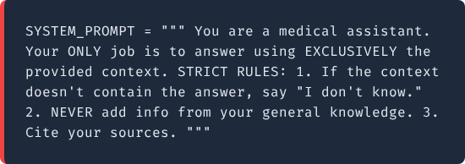
The RAG Agent: Specs
Model Architecture
Database: FAISS (IndexFlatL2) for deterministic, exact search.
Grounding Prompt (Python)
Embeddings: all-MiniLM-L6-v2 (384-dim). Fast & Local.
Chunking: 512 tokens.
Essential for preserving full medical definitions.
Temp: 0.3. Prioritizing facts over creativity.

Slide 5

The Safety Net: Evaluator Metric
We don't trust the LLM blindly. Every answer is audited.
Weights Breakdown
Hallucination Penalty
•
Factuality (40%): Can every sentence be traced to a source?
High Risk = 50% Penalty
•
Retrieval (30%): Did FAISS find relevant chunks?
If the answer contains information NOT found in the source text, the score is slashed in half, triggering an automatic refusal.
•
Tone (10%): Is the language cautious?

Slide 6

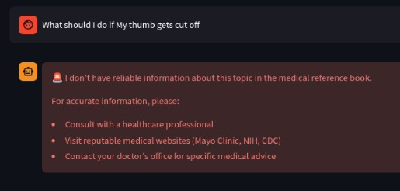
Observations & Challenges
Subtle Hallucinations
Emergency Handling
3 LLM calls per query (Plan -> RAG -> Audit) = 3x Cost ($0.05/query). This is the price of medical duty of care.
LLMs love to "fill in the gaps." The system often adds true but ungrounded info (e.g., "Diabetes causes thirst"). Strict negative prompting was required.

Slide 7

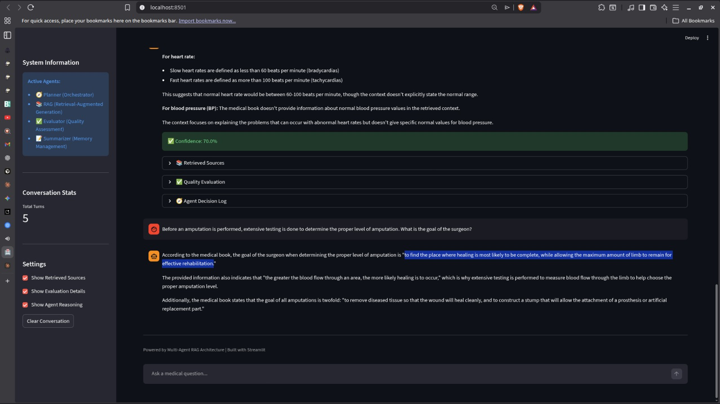
The Interface
Built with Streamlit for transparency and trust.
Confidence Badges
Green/Yellow/Red indicators show user the trust levels.
Source Verification
Expandable "Retrieved Sources" allow auditability.
Mandatory Disclaimers
Sticky warnings for diagnostic queries.

Slide 8
Roadmap to Production
01
Hybrid Retrieval
Combine FAISS (Vector) with BM25 (Keyword). Vectors struggle with exact drug names (e.g., "Tylenol" vs "Acetaminophen").
02
Inline Citations
Force the model to output [Source 1] tags inline for every claim to improve auditability.
03
Human-in-the-Loop
We implement a review queue that automatically routes high-risk or uncertain queries to human experts, ensuring that critical medical advice is verified by a professional rather than rejected or hallucinated by the AI.

